Slide 1
Lecture 14: Evaluation Analysis
DS 4200
Spring 2022
Prof. Ab Mosca (they/them)
Northeastern University
Slides and inspiration from Cody Dunne, Michelle Borkin, Remco Chang, Dylan Cashman, Krzysztof Gajos, Hanspeter Pfister,
Miriah Meyer, Jonathan Schwabish, and David Sprague

Slide 2
Last Class
We:
Reviewed Validation and Evaluation
Started ic-13 – Experiment Tutorial
Any Questions?

Slide 3
Today
Review evaluation analysis
Finish ic-13 –Experiment Tutorial

Slide 4
Validation and Evaluation Recap

Slide 5
Evaluation Design
1) Goal
→ Munzner’s nested model
2) Method
→ Select an evaluation technique
3) Who
→ Who are your participants (and how many)
4) Tasks
→ What will the participant do
5) Metrics
→ Decide what data to collect
6) Analysis
→ How will you analyze collected data
Validation
Notes:
In our first lecture about evaluation and validation we talked about the first 6 important pieces to designing an evaluation. <next>

Slide 6

Evaluation Design
1) Goal
→ Munzner’s nested model
2) Method
→ Select an evaluation technique
3) Who
→ Who are your participants (and how many)
4) Tasks
→ What will the participant do
5) Metrics
→ Decide what data to collect
6) Analysis
→ How will you analyze collected data
Validation
Notes:
We focused specifically on the first 5. Let’s recap what we covered.

Slide 7
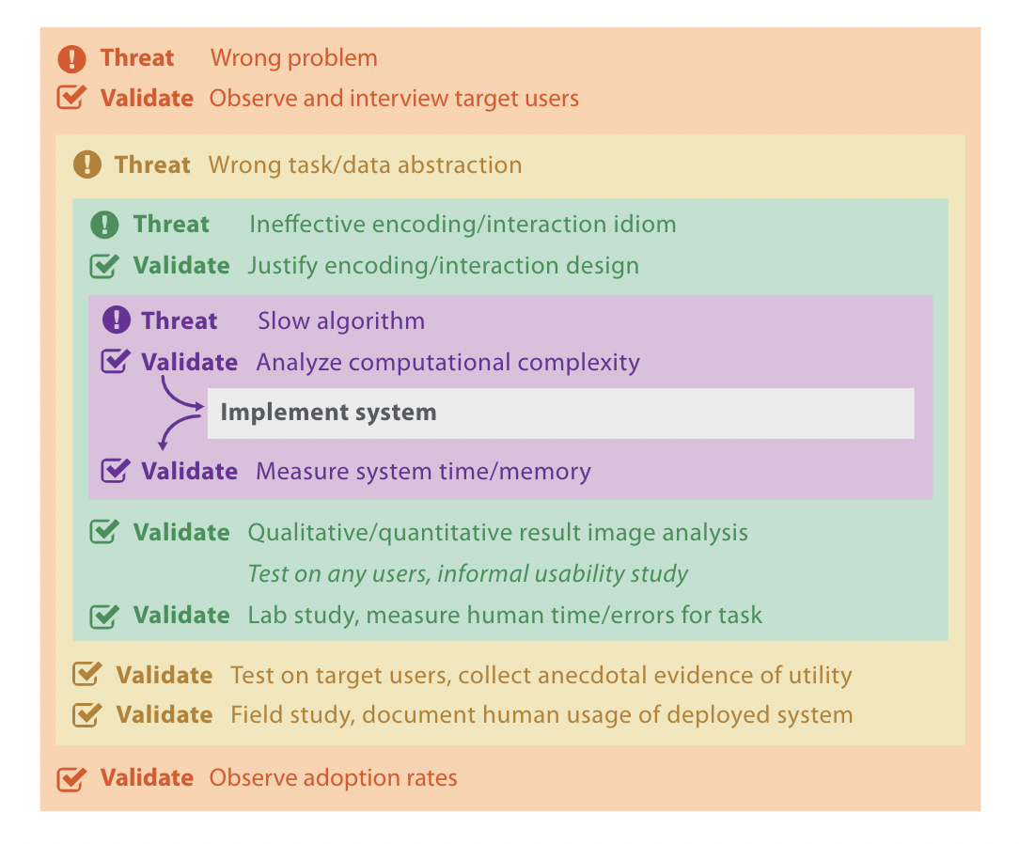
Goal: Munzner’s Nested Model
Design Pipeline
Threats to validity exist at each stage of visualization design
Validate every step using appropriate technique
Validation
Notes:
With respect to identifying the goal of an evaluation, we talked about Munzner’s Nested Model for visualization design and evaluation.
This pipeline breaks the design of visualization tools into a series of nested steps which include identifying the domain problem that the visualization will address, performing data and task abstraction, designing a visual idiom, and implementing the visualization tool.
Last time we talked about different examples of mistakes (or as Munzner says, threats to validity) that can occur at each of these steps in the design process.
<read example on slide>
Finally, we talked about how to can scope our evaluations by deciding which specific step or steps we want to validate, and designing an evaluation accordingly.

Slide 8
Method
Theoretical / Simulation Based
→ Inspection or Principled Rationale
→ Theoretical Analysis
→ Benchmarks
Human Subject Experiments
Controlled Experiment
Observational Study
→ Field Deployment or Case Studies
Validation
Notes:
Last time we also talked about different methods of evaluation, and who we ask to participate in our evaluations.
Specifically, we looked at two different categories of evaluation: theoretical / simulation based and human subject experiments.
<recap slide>
We also talked about choosing participants appropriately for human subject experiments, which should be done with respect to the main goal of the experiment.

Slide 9

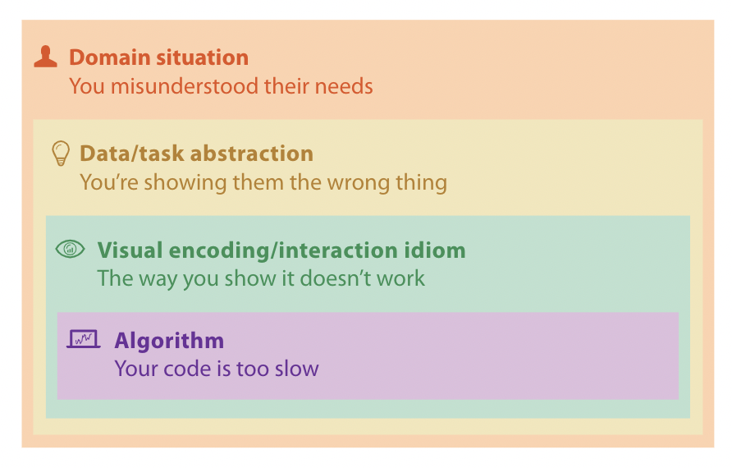


Who
Human Subject Experiments
Controlled Experiment
Observational Study
→ Field Deployment or Case Studies
Validation
Notes:
Last time we also talked about different methods of evaluation, and who we ask to participate in our evaluations.
Specifically, we looked at two different categories of evaluation: theoretical / simulation based and human subject experiments.
<recap slide>
We also talked about choosing participants appropriately for human subject experiments, which should be done with respect to the main goal of the experiment.

Slide 10
Tasks
Tasks depend on goal
Typical workflow
Find something interesting
Find outliers
Report difference between X and Y
Find/explain trend(s)
Notes:
The last piece we talked about last time was choosing tasks and metrics for evaluations.
Similar to choosing a method and participants, we discussed how the tasks we ask participants to perform and the metrics we collect are dependent on the overarching goal of our evaluation.
For example, if we’re testing how well we designed our visual idiom, we’ll likely want to have our participants perform a specific task with a ground truth solution we can compare against to judge speed and accuracy.
On the other hand, if we’re trying to evaluate how well we understood a domain problem, then we’ll likely want to do an observational study of participants using our tool and see how often and in what ways it is used.

Slide 11
Metrics
Metrics depend on goal and task
Common metric choices include:
- Speed
- Accuracy
- Quality of finding
- Satisfaction
- Recall/Memorability
- Requiring help
- Completeness and Thoroughness of Analysis
- False Positives and False Negatives
- Immersiveness
- Deviation from optimality
- Information accessed
- Use frequency
→ How often do users use this tool?
- Effort / Ease of Use
→ Cognitive
→ Physical (how many clicks did it take)
→ NASA-TLX
Notes:
The last piece we talked about last time was choosing tasks and metrics for evaluations.
Similar to choosing a method and participants, we discussed how the tasks we ask participants to perform and the metrics we collect are dependent on the overarching goal of our evaluation.
For example, if we’re testing how well we designed our visual idiom, we’ll likely want to have our participants perform a specific task with a ground truth solution we can compare against to judge speed and accuracy.
On the other hand, if we’re trying to evaluate how well we understood a domain problem, then we’ll likely want to do an observational study of participants using our tool and see how often and in what ways it is used.

Slide 12
Evaluation Design
1) Goal
→ Munzner’s nested model
2) Method
→ Select an evaluation technique
3) Who
→ Who are your participants (and how many)
4) Tasks
→ What will the participant do
5) Metrics
→ Decide what data to collect
6) Analysis
→ How will you analyze collected data
Validation
Notes:
The last piece to designing an evaluation is determining an analysis approach. That’s what we’re going to focus on today.

Slide 13
Analysis

Slide 14
Analysis
1) Goal
→ Munzner’s nested model
2) Method
→ Select an evaluation technique
3) Who
→ Who are your participants (and how many)
4) Tasks
→ What will the participant do
5) Metrics
→ Decide what data to collect
6) Analysis
→ How will you to analyze collected data
Notes:
The analysis technique you use is going to depend largely on the evaluation method you select. <next>

Slide 15
Evaluation Methods
Theoretical / Simulation Based
Inspection or Principled Rationale
Theoretical Analysis
Benchmarks
Human Subject Experiments
Controlled Experiment
Observational Study
→ Field Deployment or Case Studies
Validation
Notes:
For example, each of the evaluation methods show here will result in different types of analyses

Slide 16
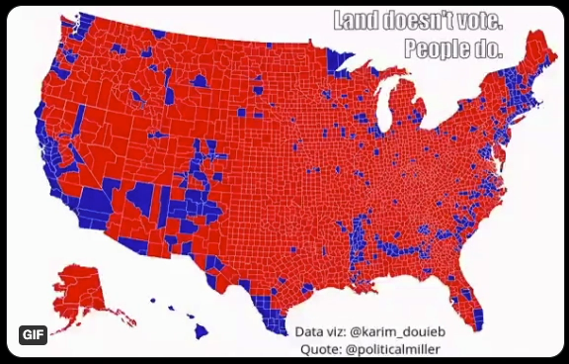
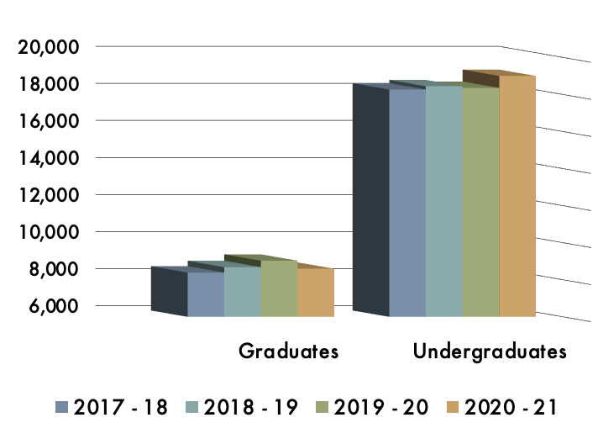
Evaluation Methods
Theoretical / Simulation Based
Inspection or Principled Rationale
→ Apply design heuristics, perceptual principles
→ Qualitative comparison to
design guidelines
Ex. This uses the wrong data –
channel mapping
Ex. This violates a design rule of
thumb
Validation
https://twitter.com/bettinaforget/status/1324139878666391555?lang=en
Notes:
Let’s start by looking at Theoretical/simulation based evaluations.
The first category under this umbrella is inspection or principle based rationale. This amounts to analyzing visualizations by examining how well they adhere to things like design heuristics (ex. The design rules of thumb we talked about earlier), or perceptual principles (ex. Gestalt principles, color perception).
The second category under this umbrella is theoretical analysis. This refers to things like analyzing algorithm time and space complexities. In other words how long will this algorithm take to run and how much space does it need.
The final category under this umbrella is benchmarks. This method evaluates a visualization by comparing it’s performance to well known benchmarks in different areas. For example comparing the interactive frame rate of your visualization to the industry standard, or looking at how well your visualization would scale for larger datasets.

Slide 17
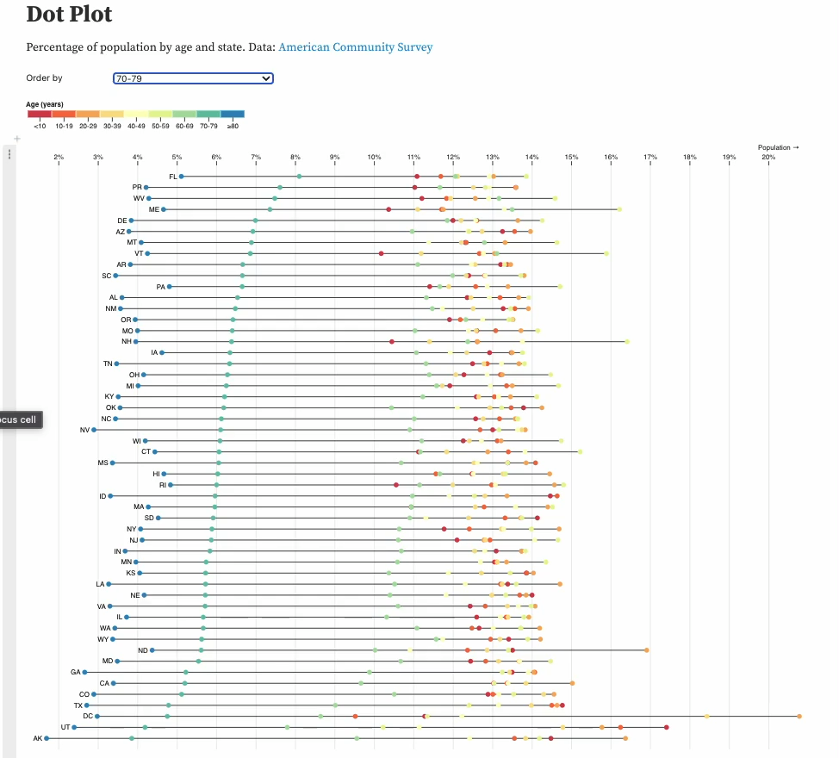
Evaluation Methods
Theoretical / Simulation Based
Theoretical Analysis
→ Algorithm time and space complexity
→ O(n) analysis
Ex. This loads in O(n), whereas this loads in O(n²)
Ex. This filters in O(log n) whereas this filters in O(n²)
Validation
https://observablehq.com/@d3/dot-plot
Notes:
Let’s start by looking at Theoretical/simulation based evaluations.
The first category under this umbrella is inspection or principle based rationale. This amounts to analyzing visualizations by examining how well they adhere to things like design heuristics (ex. The design rules of thumb we talked about earlier), or perceptual principles (ex. Gestalt principles, color perception).
The second category under this umbrella is theoretical analysis. This refers to things like analyzing algorithm time and space complexities. In other words how long will this algorithm take to run and how much space does it need.
The final category under this umbrella is benchmarks. This method evaluates a visualization by comparing it’s performance to well known benchmarks in different areas. For example comparing the interactive frame rate of your visualization to the industry standard, or looking at how well your visualization would scale for larger datasets.

Slide 18
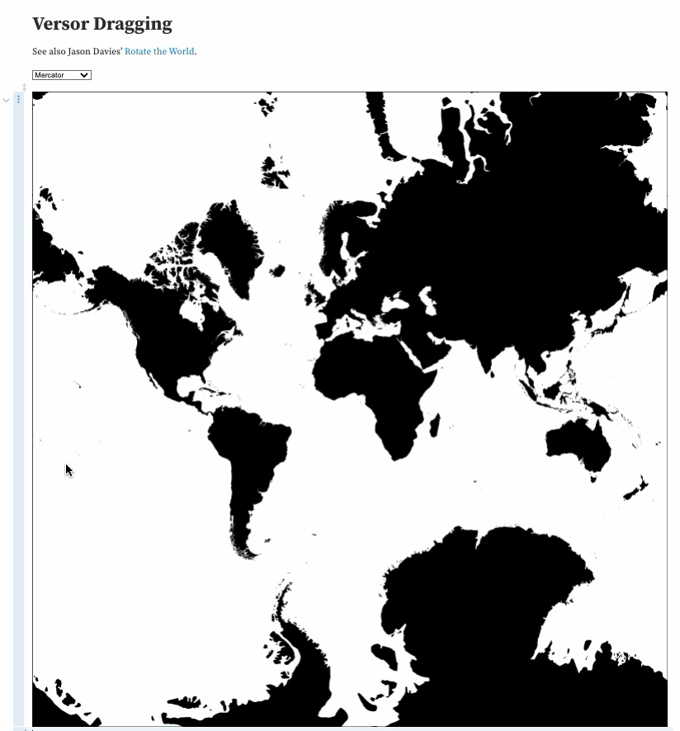
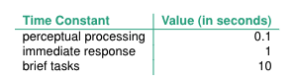
Evaluation Methods
Theoretical / Simulation Based
Benchmarks
→ Scalability to larger data sets
→ Performance (e.g., interactive
frame rates)
→ Quantitative comparison to
industry standards
Ex. This responds to interaction in less than 1 second
Validation
https://observablehq.com/@d3/versor-dragging
Notes:
Let’s start by looking at Theoretical/simulation based evaluations.
The first category under this umbrella is inspection or principle based rationale. This amounts to analyzing visualizations by examining how well they adhere to things like design heuristics (ex. The design rules of thumb we talked about earlier), or perceptual principles (ex. Gestalt principles, color perception).
The second category under this umbrella is theoretical analysis. This refers to things like analyzing algorithm time and space complexities. In other words how long will this algorithm take to run and how much space does it need.
The final category under this umbrella is benchmarks. This method evaluates a visualization by comparing it’s performance to well known benchmarks in different areas. For example comparing the interactive frame rate of your visualization to the industry standard, or looking at how well your visualization would scale for larger datasets.

Slide 19

Evaluation Methods
A
New Vis
B
Comparison Vis 1
C
Comparison Vis 2
Human Subject Experiments
Controlled Experiment
→ Specific repeated task across multiple conditions
→ Collect quantitative data (ex. time, accuracy)
→ Quantitative comparison
across conditions
Ex. T-Test, ANOVA, Chi
Squared
Task: Find all outliers in the data
Collect: Time, Accuracy
Compare data across groups
Notes:
First, controlled experiments.
These are experiments where a specific task or set of tasks are repeated across multiple conditions, and quantitative data such as time and accuracy is collected and used to compare performance across conditions.
For example, say I was designing a controlled experiment to compare vis A, a new vis I developed to Vis B and C, existing visualizations.
Let’s say I want to compare how well each visualization supports identification of outliers.
To test this with a controlled experiment, I would need one dataset that I can use in each visualization, and a set of participants (or human subjects).
Because I’m interested in how well the visualizations support outlier detection, I would assign my participants the task of identifying outliers in the data. While they did this I would record performance metrics, that I can later use to quantitatively compare performance across the three visualizations. Let’s say for this example that I collect time and accuracy on the outlier detection task.
To compare my three visualization, I would compare average time and accuracy on the outlier detection task with each visualization and look for differences. This would be done using statistical analysis.

Slide 20

Evaluation Methods
A
New Vis
B
Comparison Vis 1
C
Comparison Vis 2
Human Subject Experiments
Observational Study
→ Specific repeated task across multiple conditions (or not)
→ Collect qualitative data (ex. user findings, think-out-loud data, satisfaction) and quantitative
→ Qualitative comparison
across conditions
Ex. Coding analysis, compare
Likert scores
Validation
Task: Find all outliers in the data
Collect: Think out loud, Likert scales
Compare data across groups
Code data & compare themes
Compare # insights
Compare Likert scale evaluations on satisfaction and ease of use
Notes:
The next type of human-subject experiment we’ll talk about are observational studies.
Similar to controlled experiments, these experiments typically require a specific task or set of tasks are repeated across multiple conditions. Unlike controlled experiments, the performance metric collected for observational studies is typically qualitative. For example, user findings, recordings of user’s thinking out loud as they perform an analysis, user satisfaction and confidence ratings, etc.
Let’s walk through an example of an observational study set-up.
Say I still want to compare vis A, a new vis I developed to Vis B and C, existing visualizations just like in the previous example.
I’ll still use the same dataset and outlier detection task across visualizations, but this time instead of collecting my participants’ time and accuracy as they complete the outlier detection task I’m going to ask them to narrate their usage of the visualization tool, and to fill out a few likert scales for satisfaction and confidence after using the tool.
To analyze this qualitative data I would need to go through a process called coding, where I identify common themes in the recorded narrations, or identify the number of insights each participant found. Then I could use statistical analyses to compare outcomes from my coded data across visualization tools, and to compare likert scale reportings.

Slide 21
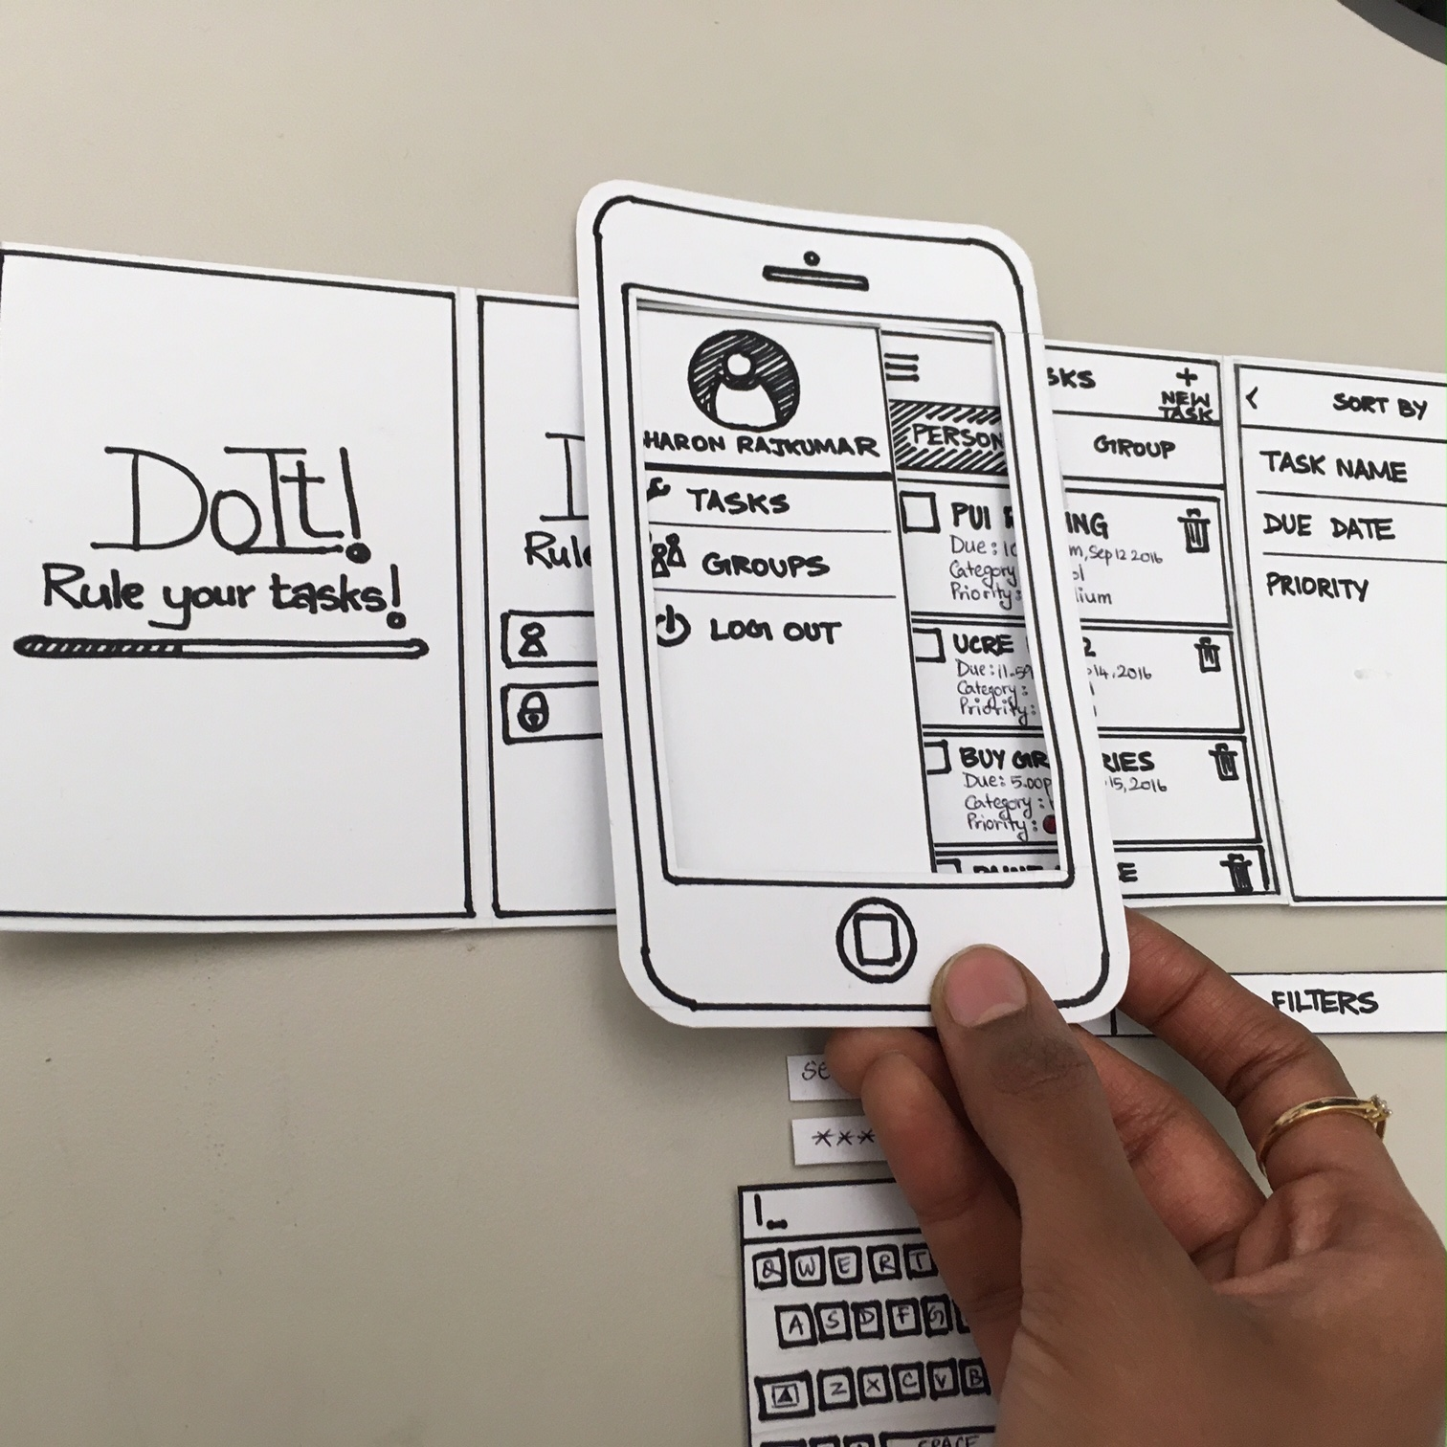
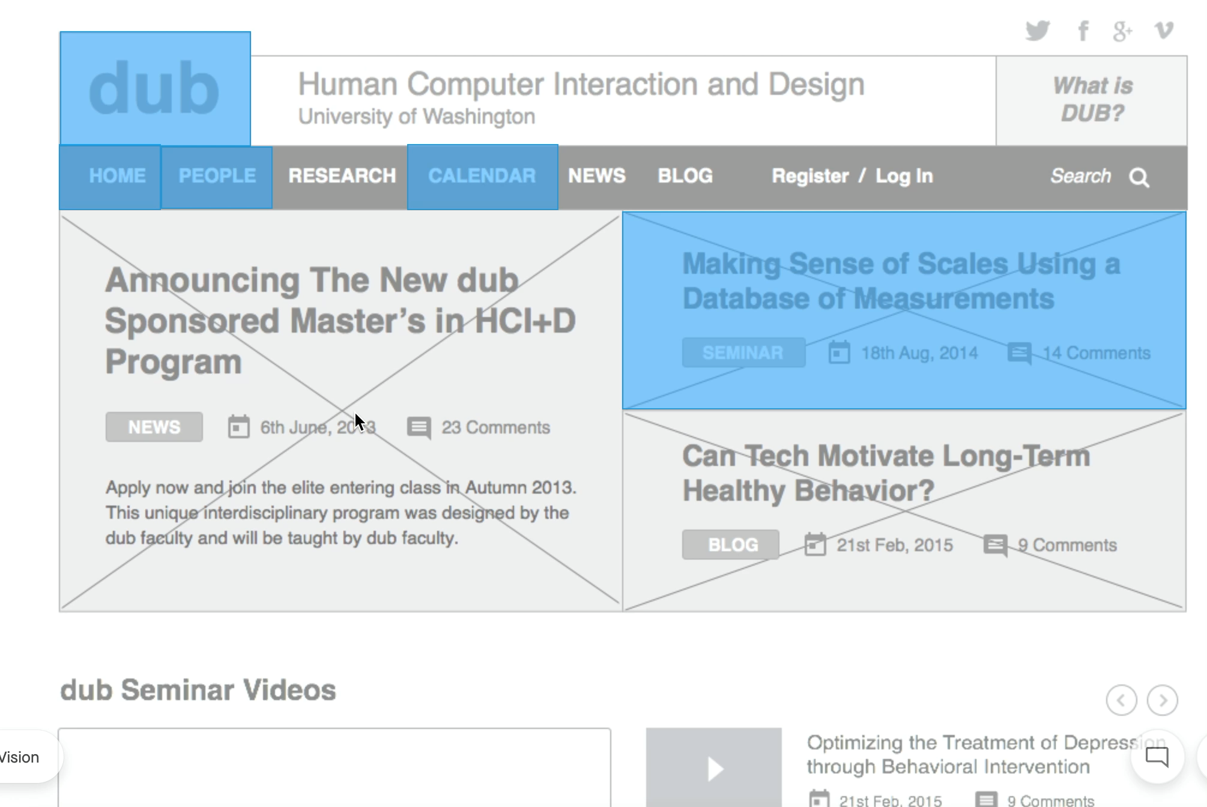
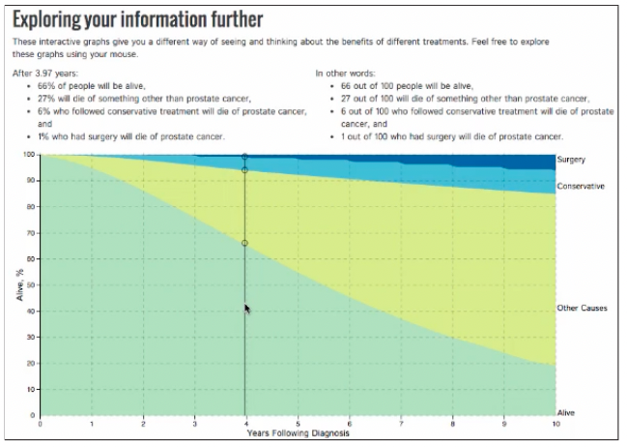
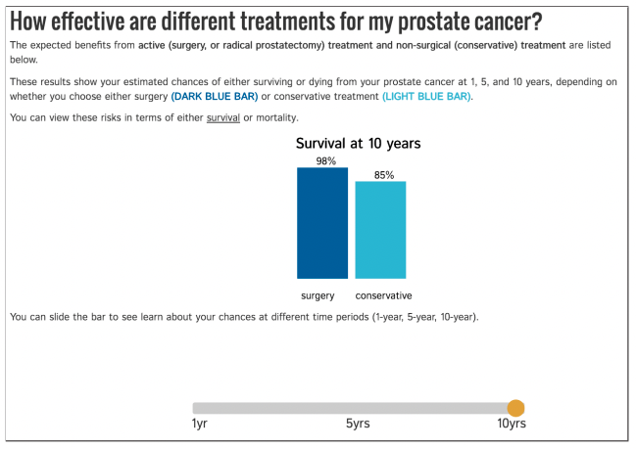
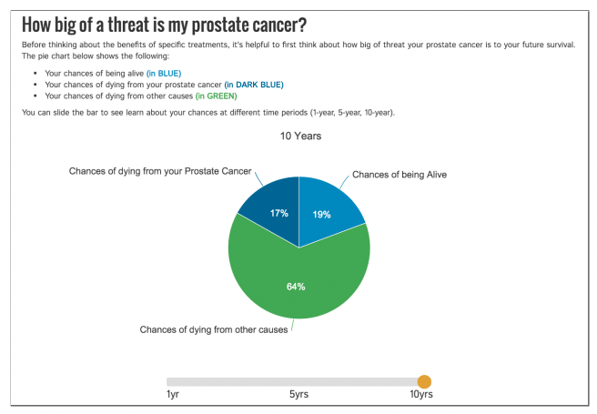
Evaluation Methods
Human Subject Experiments
Observational Study
Usability Studies
→ Observational study specifically focused on usability of a visualization
→ Range from low to high fidelity testing
Qualitative analysis
Ex. How many errors? Are
major functions missing?
Low Fidelity
→ Paper prototype
Medium Fidelity
→ Wireframe
High Fidelity
→ Working prototype
https://ieeexplore.ieee.org/stamp/stamp.jsp?arnumber=7539638
Notes:
Another type of observational study I want to touch on today is usability studies.
These are observational studies geared strictly towards evaluating a usability of a tool.
These types of studies can be formal observational studies that follow the structure I just explained, but with tasks and analyses the focus specifically on usability (for example checking narrations for recurring cases of participants being unable to find a particular button, or confused by some interactive functionality).
Or they can be something called low-fidelity tests. Low fidelity tests are used to test usability of a tool during the early design phases, as opposed to after the tool has been built in it’s entirely.
Often this is done with low-fidelity prototypes that are either made of paper (as shown here), or with wireframes which I’ll show you an example of in a moment.
In either case the set up of these studies consist of having participants perform a specific repeated task and narrating their completion of said task using a prototype of the final tool.
This can help illuminate usability issues before going through the trouble of building the entire tool. For example, these kinds of test can illuminate is a particular button is not in an intuitive spot, or if users don’t know where they should look to find some functionality, etc.

Slide 22
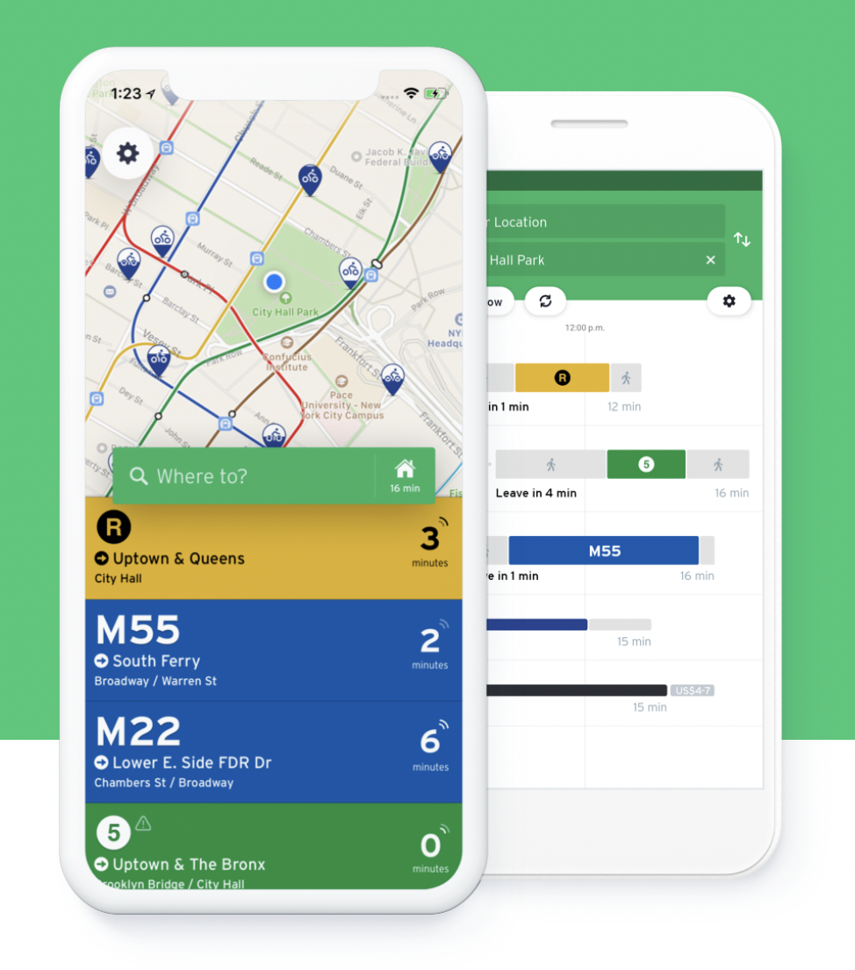
Evaluation Methods
Human Subject Experiments
Field Deployment or Case Studies
→ Deploy tool in realistic settings
→ Document effects on work practices
→ Observe usage in the “real world”
→ Collect qualitative or quantitative data (ex. satisfaction, number of times used in a week, etc.)
→ Qualitative analysis
Ex. How often is it used? Did workflow change?
Validation
https://transitapp.com/
Notes:
The final type of human subject experiment we’ll talk about today are field deployment or case studies.
For this type of experiment, a tool is deployed in a realistic setting and it’s usage and effects are observed.
As we saw earlier, this type of testing is best suited to evaluating if you understood the domain problem you were trying to solve with your visualization.
For example, pretend you created an app for the MBTA that tracked but and train arrivals and departure from stations. One way to test if that app was effective for bus and train riders would be to deploy it amongst a group of beta testers and see if those testers changed their riding behavior, based on the app.

Slide 23
Evaluation Methods
Theoretical / Simulation Based
Inspection or Principled Rationale – Qualitative comparison to design guidelines
Theoretical Analysis – O(n) analysis
Benchmarks – Quantitative comparison to industry standards
Human Subject Experiments
Controlled Experiment – Quantitative comparison across controlled conditions
Observational Study – Quantitative or qualitative comparison
Field Deployment or Case Studies – Qualitative or quantitative analysis “in the wild”
Validation
Notes:
Out of all of these evaluation methods, by far the most commonly used in visualization are controlled experiments and observational studies. Both of these require controlled conditions, and unbiased distribution of participants among those conditions, which is what we’re going to talk about next.

Slide 24
Controlled Experiment Design
A
New Vis
B
Comparison Vis 1
C
Comparison Vis 2
Human Subject Experiments
Controlled Experiment
→ Specific repeated task across multiple conditions
→ Collect quantitative data (ex. time, accuracy)
→ There are many ways to design a controlled experiment (i.e. many experimental designs). We’ll touch on some more later.
Task: Find all outliers in the data
Collect: Time, Accuracy
Compare data across groups
Notes:
One things I want to highlight here, is that there are many ways to design controlled experiments. We’ll come back to discussing design options later
For now, what I want you to know is that controlled experiments rely on a specific repeated task across multiple conditions, and they collect quantitative data as a performance metric.

Slide 25

Between Subject Design →Each participant sees one stimuli →Typically randomize stimuli assignment
Controlled Experiment Design
Within Subject Design →Each participant sees all stimuli
→Typically randomize stimuli order
A
New Vis
A
New Vis
B
Comparison Vis 1
B
Comparison Vis 1
C
Comparison Vis 2
C
Comparison Vis 2
Notes:
So, as I just said, when we are designing controlled experiments we need to think about assigning participants to different controlled conditions.
There are two ways to organize this assignment, referred to as between subject experiments and within subject experiments.
With between subject experiments <read>
With within subject experiments <read>
Of course there are pros and cons to each of these set ups. <next>

Slide 26
Between Subject Design →Pros → No risk of learning effects →Cons → Requires larger sample → No direct comparisons (same person) between conditions
Controlled Experiment Design
Within Subject Design →Pros
Direct comparison (same person) between conditions
More data with fewer participants
Cons
Learning effect
A
New Vis
A
New Vis
B
Comparison Vis 1
B
Comparison Vis 1
C
Comparison Vis 2
C
Comparison Vis 2
Notes:
The pro of a between subject design is that there is no risk of learning effects, meaning you don’t have to account for the fact that participants may become better at a task simple because they’ve repeated it multiple times.
The Cons of a between subject design are that it requires a larger sample of participants than a within subject design for the same number of trials. Ex. Here I get 9 trials with the BS design, and 27 with the WS design.
And that you cannot perform direct comparisons between conditions. In other words, you cannot see how participant 1 performed the task with each visualization, you can only look at how participants performed with different visualizations on average.
The pros of a within subject design are that you can do that direct comparison, and that you do get more data (trials) with fewer participants.
The con is that there is a risk of a learning effect, which is potential error that needs to be accounted for when you perform your analysis.
<next>

Slide 27
Mixed → Experiment with a combination of between and within subject factors → Factors = variable aspects of an experiment
Controlled Experiment Design
Encoding
Bar
Pie
Line
Interactive
Y N
A
B
C
D
E
F
Notes:
Another important thing to know about designing experiments is that we can design them to test multiple factors at once, and when we do this we can mix and match between and within subject designs.
For example here, I’m showing an experiment with two factors: Encoding, and Interactive. Each of these factors has different levels, or values. For example Encoding’s levels are bar, pie, and line. And Interactive’s levels are yes and no.
As I’ve illustrated here, each participant will use interactive and static visualizations or in other words interactive is a within subjects factor.
And each participant will only use one encoding (bar, pie, or line) which makes encoding a between subjects factor.

Slide 28
Statistical Analyses
Results of statistical analyses allow us to statistically say whether two (or more) groups of subjects behave differently given different treatments (with all other differences controlled)
Disclaimer: statistics is a deep field. Our goal today is to give you a “way to think” about statistics with respect to controlled user study evaluations
Notes:
Now that we’ve talked about setting up experiments, let’s talk about statistical analysis, or in other words, quantitative analysis.
<read>
So, given an experiment, how do we select the appropriate analysis?

Slide 29
Statistical Analyses
Analyses start with a research question
→ This question relates to the goal of your evaluation
→ Ex. Does my visualization reduce the time it takes to complete Task A
compared to the current state-of-the-art?
That research question is translated into a testable null hypothesis
→ A hypothesis is a statement that can be true or false
→ A null hypothesis is the statement that nothing new or interesting is happening
→ Ex. There is no difference between the amount of time it takes people to
complete Task A with my visualization versus the current state-of-the-art.
Notes:
Selecting the appropriate analysis starts with a research question that then gets translated into something called a null hypothesis.
<read>
<next>

Slide 30
Hypotheses
Research Question: Does my new visualization (V1) help people more accurately identify outliers in data than my old visualization (V2)?
Null Hypothesis
→ H₀:
Alternative Hypothesis
→ H_{A}:
Notes:
While null hypothesis are the hypothesis that nothing new or interesting is happening, alternative hypotheses are the opposite, or in other words what is true if the null hypothesis is false.
For example, given this research question what would the null and alternative hypotheses be?

Slide 31
Hypotheses
Research Question: Does my new visualization (V1) help people more accurately identify outliers in data than my old visualization (V2)?
Null Hypothesis
→ H₀: People using V1 identify outliers with the same accuracy as people using V2.
Alternative Hypothesis
→ H_{A}: People using V1 identify outliers with different accuracy than people using V2.
Notes:
The null hypothesis would be that there is no difference between V1 and V2, and the alternative would be that there is a difference.
<next>

Slide 32
Hypotheses
Null Hypothesis
→ H₀: People using V1 identify outliers with the same accuracy as people using V2.
Alternative Hypotheses
→ H_{A}: People using V1 identify outliers with different accuracy than people using V2. (2 tailed)
→ H_{A1}: People using V1 identify outliers with the higher accuracy than people using V2. (1 tailed)
→ H_{A2}: People using V1 identify outliers with the lower accuracy than people using V2. (1 tailed)
Notes:
Sometimes we’re curious to know not just if there is a difference, but the direction of that difference. In those cases we would have different alternative hypotheses, which would result in something called a one-tailed test instead of a 2 tailed test.

Slide 33
Hypotheses
Null Hypothesis
→ H₀: People using V1 identify outliers with the same accuracy as people using V2.
Metric / Response Variable
Conditions / Groups
Notes:
One last thing I want to point out is that our hypotheses include what groups or conditions are included in our experiment, and the metric or response variable that we want to compare across those groups.

Slide 34
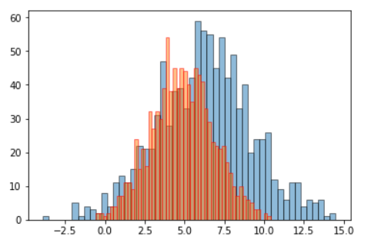
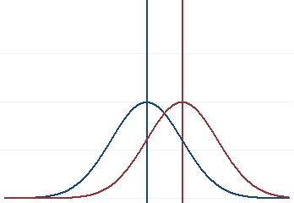
Modeling Data
We collect data, and think about that data collectively as a distribution
Most statistical tests compare distributions
Parametric tests compare normal distributions
Non-parametric tests compare non-normal distributions
Count
Measurements
Notes:
What most statistical tests do is compare 1 or more distributions of data to assess whether those two distributions are significantly different or not.
In other words, they look collectively at the outcomes from each condition of an experiment an determine whether the collective outcome given one condition is significantly different than the outcome given another.
<next>

Slide 35
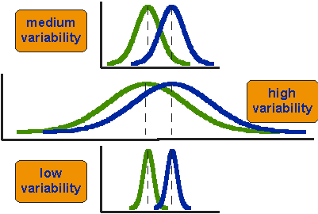
Hypothesis Testing
Parametric statistical tests compare normal distributions
They consider differences in means and amount of overlapping values (variability) when comparing distributions
Notes:
When we are working with normal data, which is what is shown here, the way we determine if one set of outcomes differs from another is to consider means and variance.
In other words, to consider the difference between average values in each group and the amount of overlapping values between each group.
These values are represented by a test statistic.
<next>

Slide 36
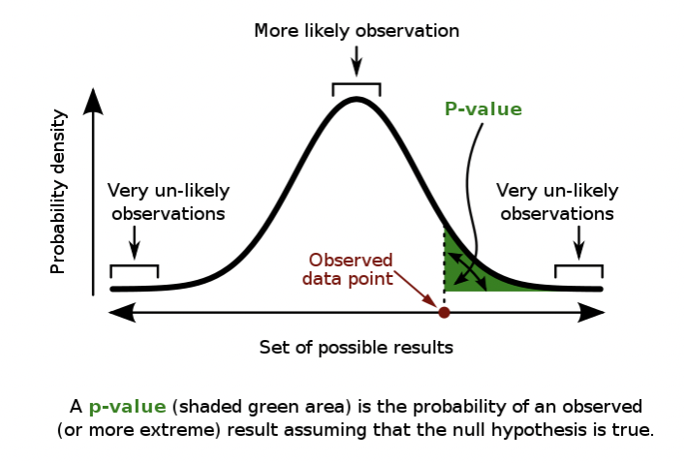
Hypothesis Testing
Statistical tests calculate a test statistic, based on experimental data and several parameters we set before hand (alpha, beta, etc.)
We compare that test statistic to some pre-determined critical threshold to determine if we reject or fail to reject the null hypothesis
Notes:
Once we have a test statistic, we check to see how likely we are to see that test statistic due to chance. If we are less than 5% likely to see that statistic due to chance, we assume we are seeing it because of whatever we were testing between conditions.
If this happens, we say we “reject our null hypothesis”. In other words, we reject the statement that there is no difference between our test conditions.
If our test statistic is not unusual then we say we “fail to reject our null hypothesis”. In other words, we don’t reject the statement that there is no difference between our test conditions.

Slide 37
Hypothesis Testing
H₀: People using V1 identify outliers with the same accuracy as people using V2.
If our test statistic is sufficiently unlikely to be seen by chance, we reject the null hypothesis
It is sufficiently unlikely that our experimental data differs from the null hypothesis only due to chance (i.e. H₀ is most likely not true).
If our test statistic is likely to be seen by chance, we fail to reject the null hypothesis
It is likely that our experimental data differs from the null hypothesis only due to chance (i.e. H₀ is most likely true)
Notes:
Once we have a test statistic, we check to see how likely we are to see that test statistic due to chance. If we are less than 5% likely to see that statistic due to chance, we assume we are seeing it because of whatever we were testing between conditions.
If this happens, we say we “reject our null hypothesis”. In other words, we reject the statement that there is no difference between our test conditions.
If our test statistic is not unusual then we say we “fail to reject our null hypothesis”. In other words, we don’t reject the statement that there is no difference between our test conditions.

Slide 38
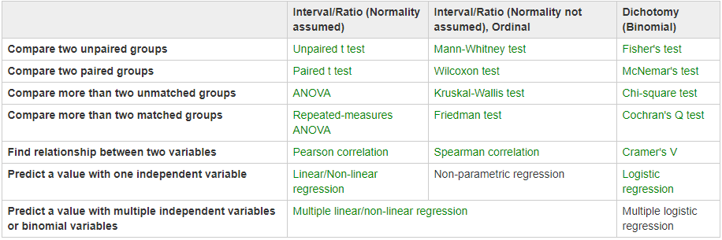
Hypothesis Testing
Selecting the appropriate statistical test depends on your data and experimental design.
Source: http://yatani.jp/teaching/doku.php?id=hcistats:start
Notes:
As a final note, there are a lot of different statistical tests that can be used for quantitative analysis. The appropriate test to use depends on your data and your experimental design.
For example the images I showed comparting two normal groups of data was a t-test. If my data were not normally distributed I would have had to use a different test, or if I had. More than 2 experimental groups I would have had to use a different test.
<next>

Slide 39
Hypothesis Testing
Selecting the appropriate statistical test depends on your data and experimental design.
Source: http://yatani.jp/teaching/doku.php?id=hcistats:start
Google is your friend! Always confirm your data meets assumptions before proceeding!
Notes:
All this is to say when you are trying to pick the appropriate statistical tests for an experiment, google is your friend. Try searching for what test you need for comparing more than two between subject groups. Or what test you need to compare two groups when your data is not normal.
And remember, whatever test you end up choosing, the first step of testing is always to ensure your data meets the assumptions of the test. For example normality.

Slide 40
Let’s take a break! Stretch, go for a walk, be social ☺ Be back here in 10 mins.

Slide 41
ic-13 – Experiment Tutorial

Slide 42
Summary
Today we:
Reviewed analysis of evaluations
Finished ic-13 – Experiment Tutorial
pm-07 is OUT today. See canvas for details.

